Slide 1




513-B Group 19 Final Project
Emma Hodor, Mihir Savalia, Samuel Miller, & Dimitrios Haralampopoulos

Slide 2
Intro to Our Dataset

Slide 3

Our Dataset - What are we trying to predict?
Our dataset gathers relevant information on US domestic flights during the 2013-2018 timespan, for the purpose of forecasting weather-related delays. In order to make such forecasts, the dataset includes scheduled and actual departure and arrival times as reported by the associated US air carrier, along with other details such as origin of flight, destination, date/time, distance, airline carrier, and delay status.
Kaggle link to our used dataset: https://www.kaggle.com/datasets/gabrielluizone/us-domestic-flights-delay-prediction-2013-2018

Slide 4
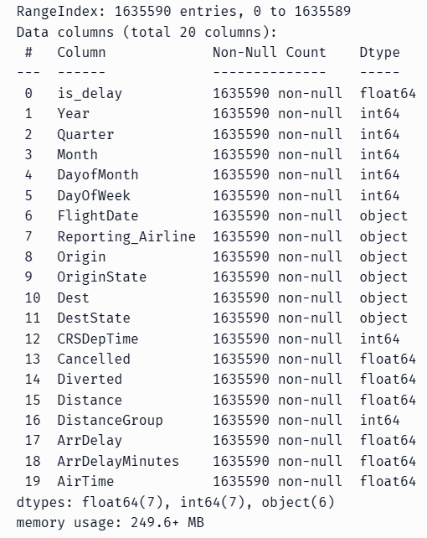
Our Dataset Schema
FlightDate transformed to Int64 for most processing
Reporting_Airline, Origin, OriginState, Dest, and DestState are all Strings
Categorical data handled differently depending on the model used
Target to predict was the is_delay column

Slide 5
Exploratory Data Analysis
is_delay
Mean = 0.21
Shows data is skewed towards no delay
No cancellations or diversions
Distance
Mean = 1101 miles
Min = 224 miles
Max = 2296 miles
ArrDelay
Mean = -14 mins
Min = -87 mins
Max = 2142 mins -> 35.7hrs
Reporting_Airline
5 unique, with American Airlines most frequent at 593k occurrences
OriginState
7 unique, with California most frequent at 445k
Origin
9 unique, with Los Angeles International Airport most frequent 243k
DestState
Same as OriginState, but with 446k occurrences
Dest
Same as Origin, but with 244k occurrences

Slide 6
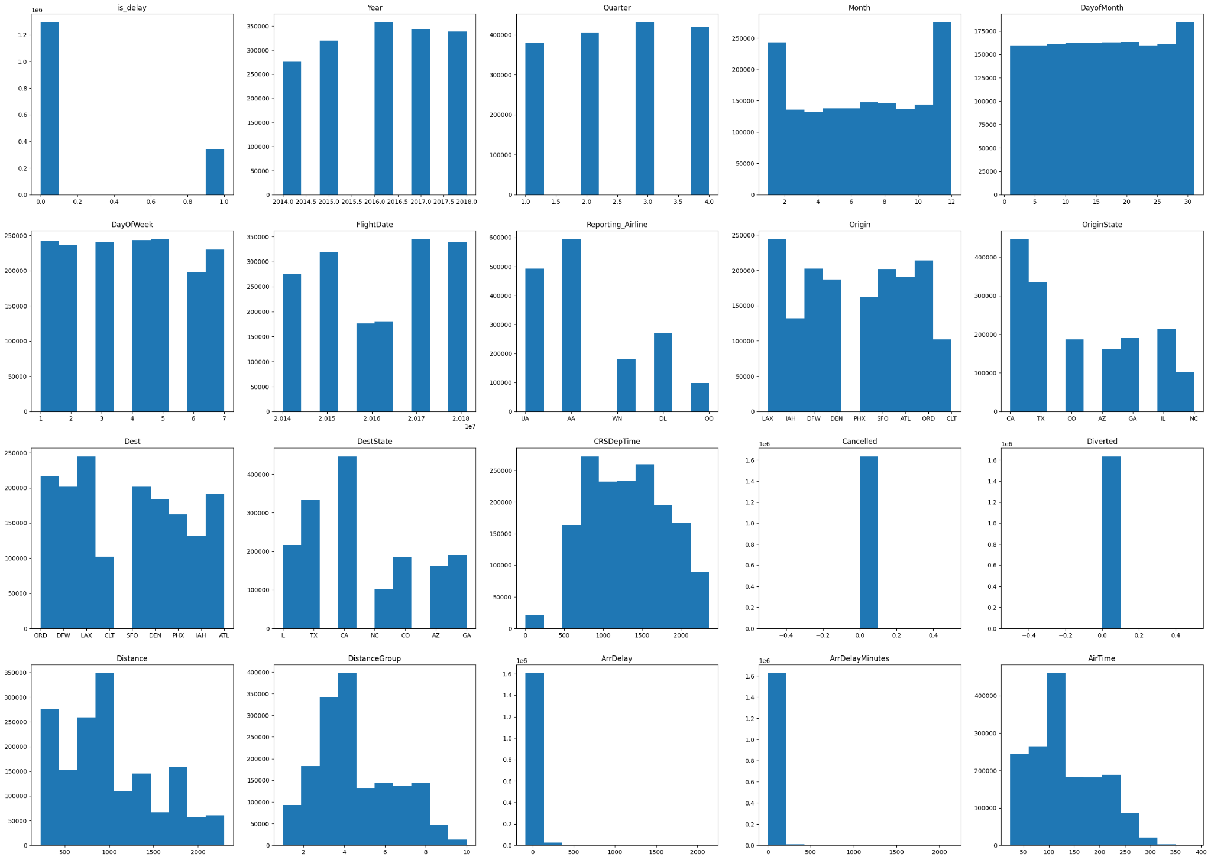
Distributions of Feature Column Data by Attribute

Slide 7
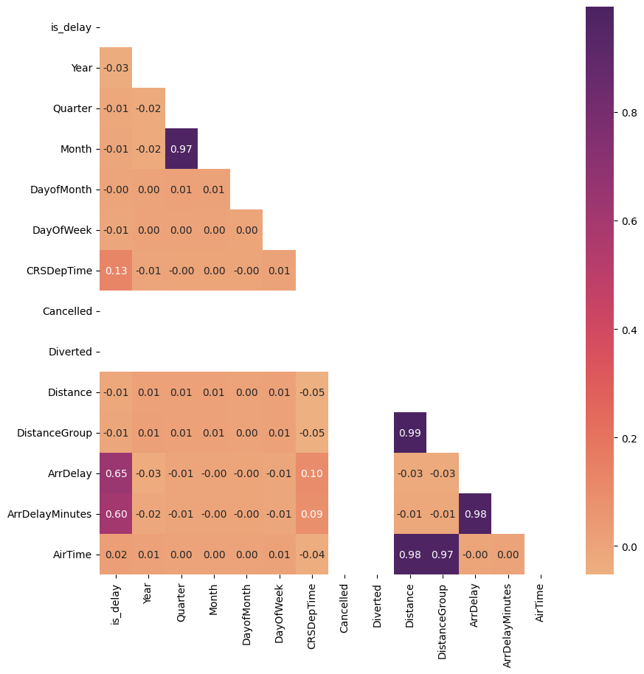
Lower-Triangular Correlation Matrix of Features

Slide 8

How can we use the data for flight delay predictions?
We can apply different Machine Learning techniques in order to allow companies to provide customers with data-based forecasts on potential flight delays. In our project, we used techniques such as:
Naive Bayes
Random Forest
K-nearest neighbor
Classification & Regression Tree
Artificial Neural Network
Hierarchical Clustering
K-Means Clustering
Logistical Regression
Some extra dataset info: The usability score is 7.06 and it is a binary classification problem, with each flight (or data point) being either delayed or not.

Slide 9
Our Machine Learning Techniques

Slide 10
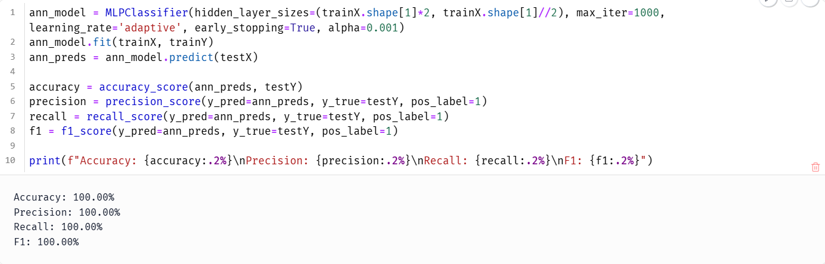
ANN Model Results
Dummy columns created for categorical data then binarized
All values scaled using Standard Scaler
Trained on test sizes 0.2 and 0.3
Multiple ANN models trained, most with single hidden layer of size of 55 (# of features including dummies)
Other models include 2 layers (55, 27)
Added adaptive learning rate, lowered alpha, early stopping, and 1000 max iters
Training results remained largely the same (~100% on eval metrics) despite efforts

Slide 11
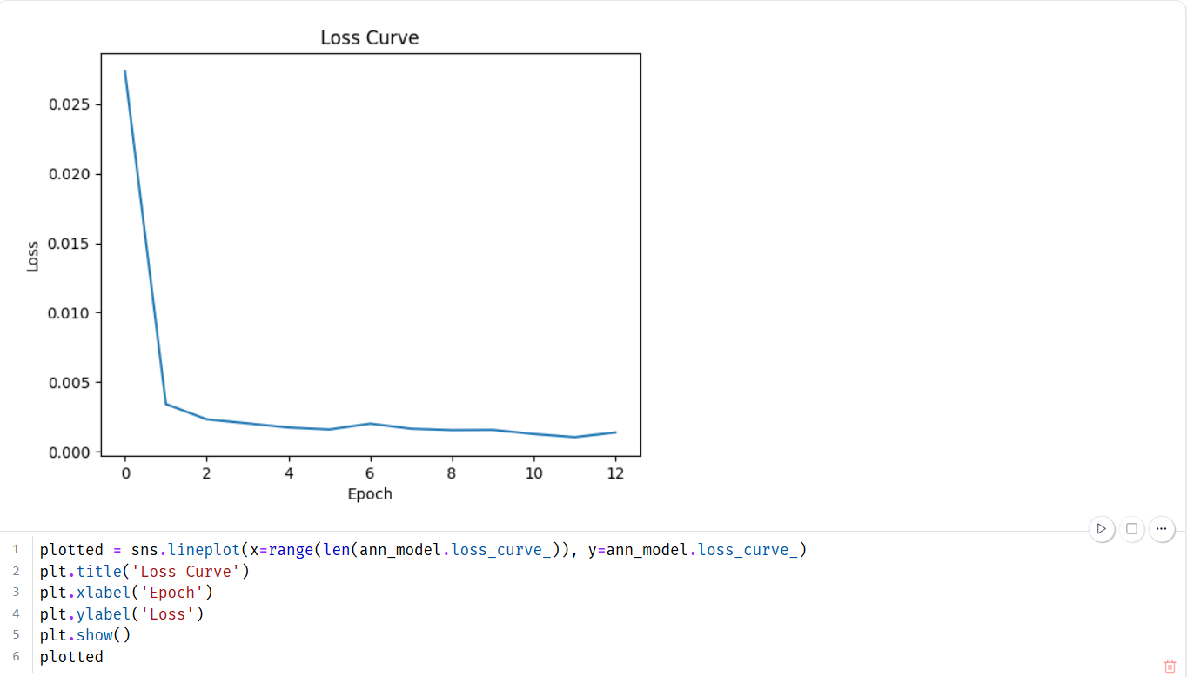
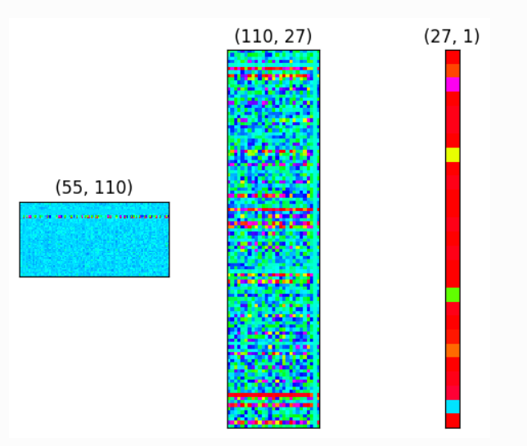
ANN Model Issues
Data required some amount of preprocessing before use
Alarmingly high metrics despite attempts to regularize are indicative of overfitting
Other regularization techniques such as dropout are possible for ANNs, but require the use of other libraries

Slide 12
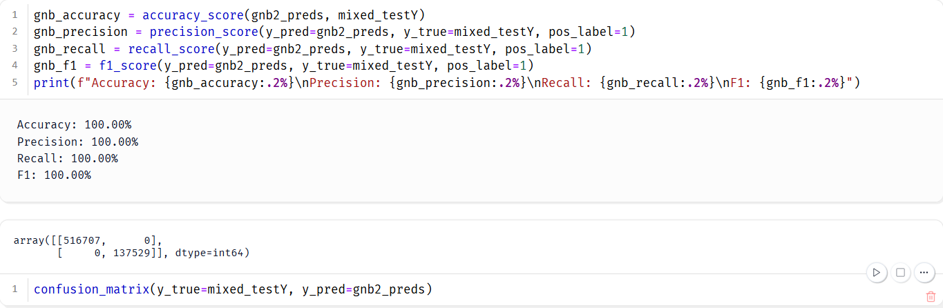
Naive Bayes Model Results
Data required One-Hot Encoding of Categorical data before processing
Numerical data was MinMax Scaled before training
Accuracy of the model was again 100%, as were the other metrics
Harder model to overfit than others, more likely to underfit (https://stats.stackexchange.com/questions/543494/how-can-naive-bayes-overfit-the-data)

Slide 13
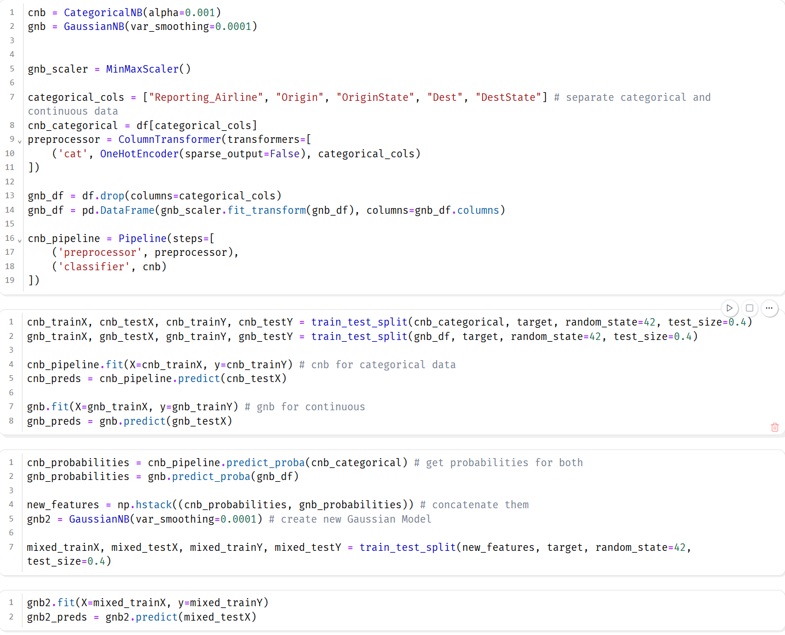
Naive Bayes Model Issues
No metrics changed even when alpha was raised and test size increased
Because of clashing data types (categorical and continuous), a single model was not sufficient
3 models had to be trained:
Categorical - CNB
Continuous - Gaussian NB
Concatenated class probabilities - GNB
Credit to ogrisel on StackOverflow for helping me solve this issue

Slide 14
CART Model Results
How did I prepare the data?
The data does not have to be prepared before fitting the model, as one of the advantages of CART is its usability on both continuous (regression) and categorical (classification) data, which our dataset has both. CART is also robust against outliers in our data and can handle missing values (though our dataset doesn’t have missing values). The CART algorithm creates a decision tree where each node has a prediction for the target variable (is_delayed, a boolean) at the end.
How accurate was the model on test data?
After properly experimenting and setting my hyperparameters on my CART model, I ended up with an accuracy of 99%. The model was first trained on the training set of the data (set by sklearn’s train_test_split function to ensure randomness) and then applied to the testing set, which encompassed 20% of the data.

Slide 15
CART Model Issues
What issues did I run into while figuring out my CART model?
I first created my CART model without setting any hyperparameters, not realizing how this would lead to one of CART’s major flaws - overfitting data. My first model tree was getting 100% accuracy and perfectly predicting every flight delay, which seems like a good outcome but actually means my model was essentially memorizing the training data, making it much less usable on unseen data.
What did I change to fix the overfitting?
As seen in the code below, I added hyperparameters to the Classifier function to ensure there was a cap on the maximum depth, maximum number of leaf nodes, and maximum number of features to use when looking for the best split in the tree.

Slide 16
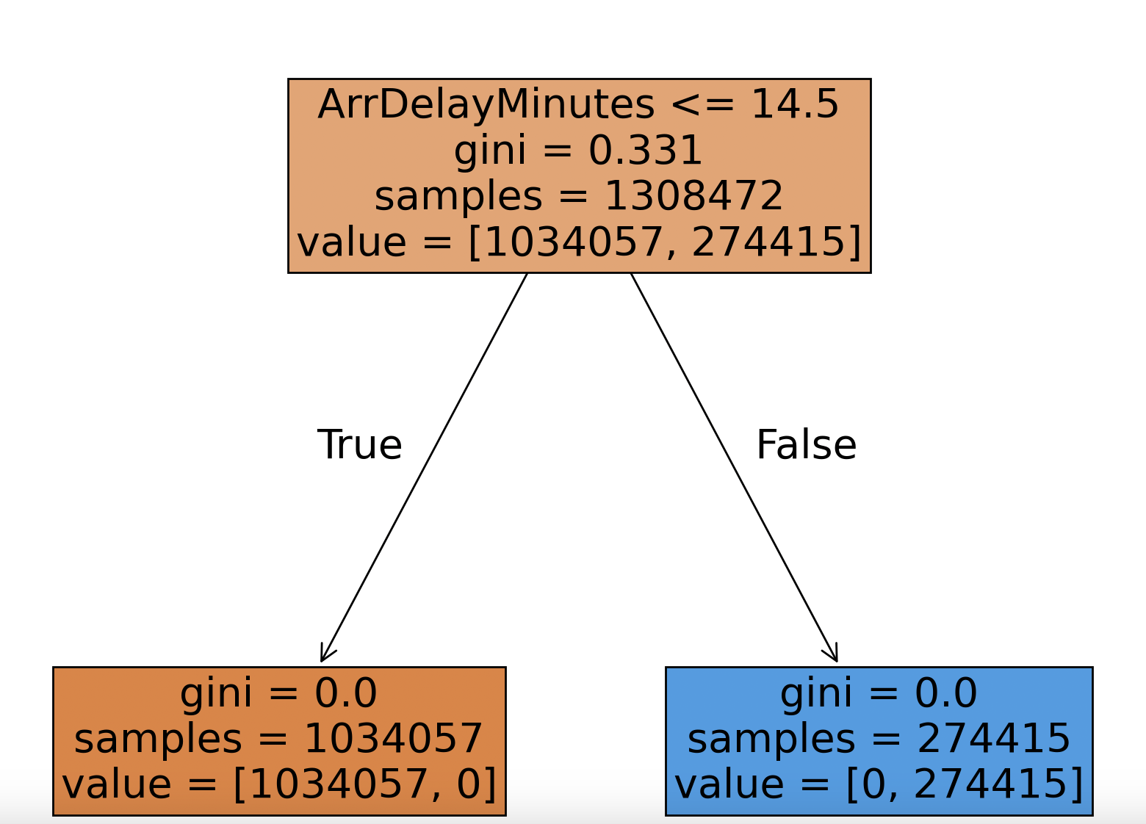
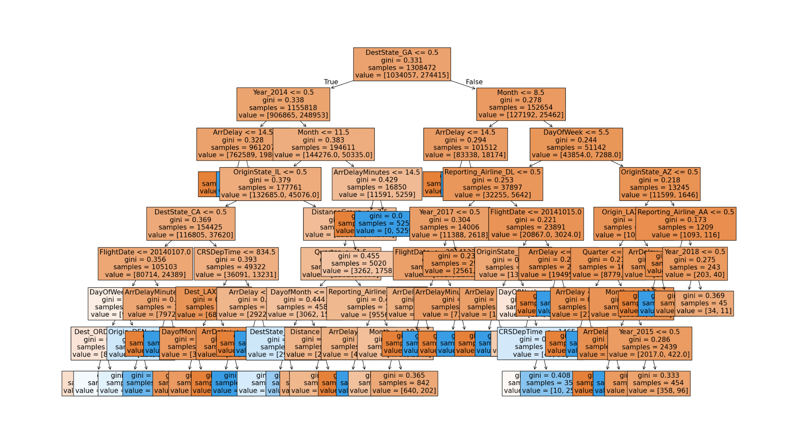
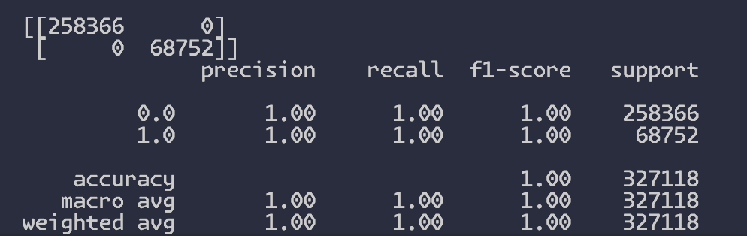
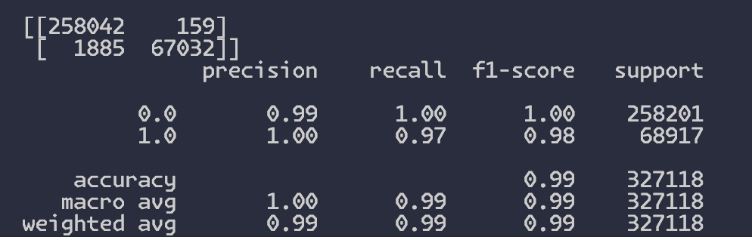
CART Trees
Initial CART Tree:
Final CART Tree:

Slide 17
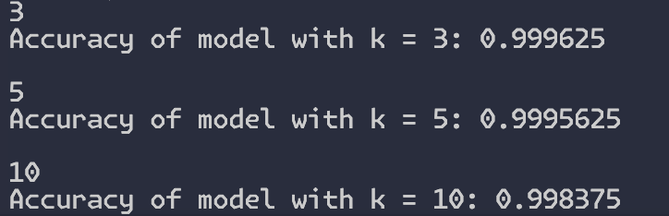
KNN Model Results
How accurate was the model on test data?
After properly setting up my KNN model and fitting it on the training data, I ended up with a nearly 100% accuracy rate while predicting on the test data. I tested three different k values. Smaller k values may cause overfitting, while larger k values can better ignore outliers at the expense of overlooking locally-interesting data points. Though all were close in accuracy, a k value of 3 ended up with the highest accuracy.
How did I prepare the data?
The KNN model calculates distance in order to compare records and find the k-nearest neighbors (or matches). This means I had to normalize the continuous data to prevent large values in certain columns overwhelming other columns, along with one-hot encoding the categorical columns since KNN won’t understand the categories otherwise. For normalizing, I used a MinMaxScaler. For categorical data, I used the sklearn module’s OneHotEncoder.

Slide 18
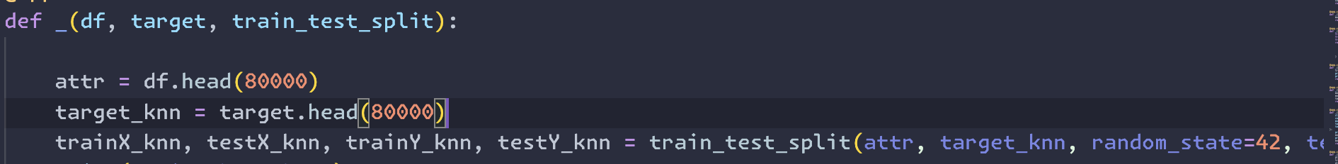
KNN Model Issues
What issues did I run into while figuring out my KNN model?
When first trying to run my KNN model, I ran into difficulties since it seemed to run forever. I did research and saw that KNN has a much higher time complexity during prediction than other models, such as CART. CART has a time complexity of O(log n) per prediction, while KNN has a complexity of O(n*d) per prediction (for n training points and d features). This is due to KNN, for each test sample, having to calculate distances to every training sample to find the closest neighbors based on feature similarity. To solve this problem, I had to use only the first 80,000 rows of the dataset in order to run the model in a reasonable time.

Slide 19
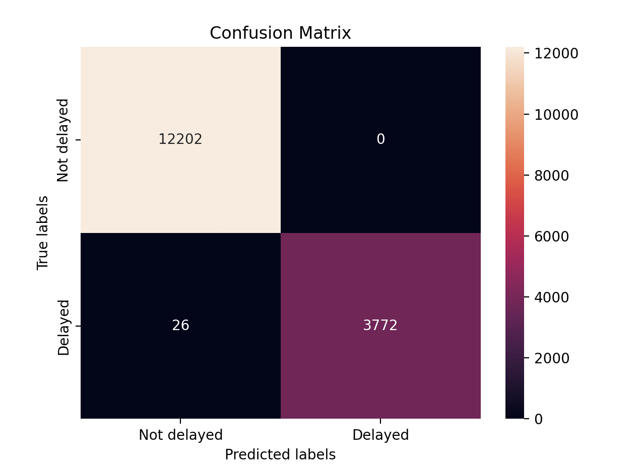
KNN Confusion Matrix
Matrix for k=10:
The model incorrectly predicted delay status for only 26 delayed flights and 0 not-delayed flights

Slide 20
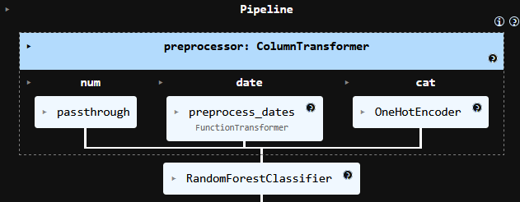
Random Forest Model
Separated categorical and numerical data, allowing for One Hot Encoding of categorical features
Column Transformer and Pipeline to couple the preprocessor and classifier
Classifier:
n_estimators = 100
max_depth = 10
class_weight = balanced
Balanced class weight accounts for unbalanced data
Used 20% testing size

Slide 21
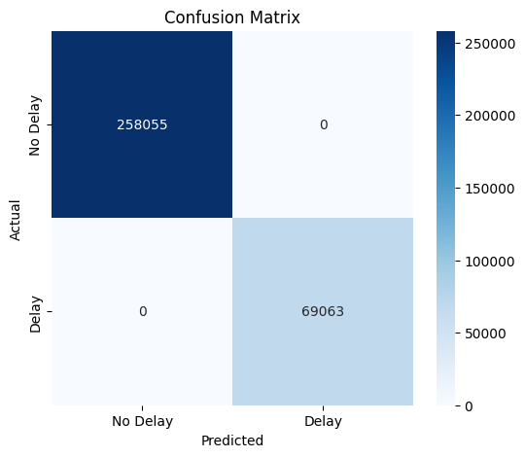
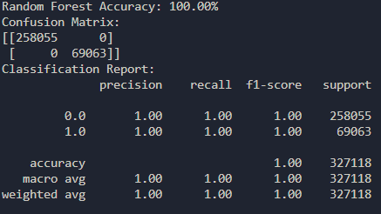
Random Forest Results
Accuracy: 100%
No false positives or false negatives
Adjusting hyperparameters did not affect accuracy

Slide 22
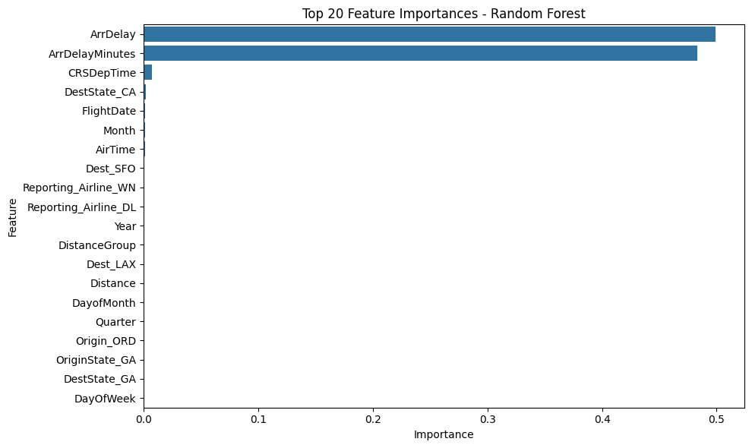
Random Forest Issues
Feature Importance
Reveals ArrDelay, and ArrDelayMinutes, as extremely important features for classification
This most likely is leading to the perfect accuracy seen in our models, and was initially overlooked

Slide 23
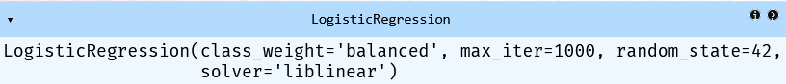
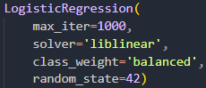
Logistic Regression Model
Train-test split: 30% test, 70% training
Logistic Regression Classifier:
max_iter = 1000
class_weight = balanced
solver = liblinear
Liblinear is good for linear classifiers, as in this case, with a binary classification problem

Slide 24
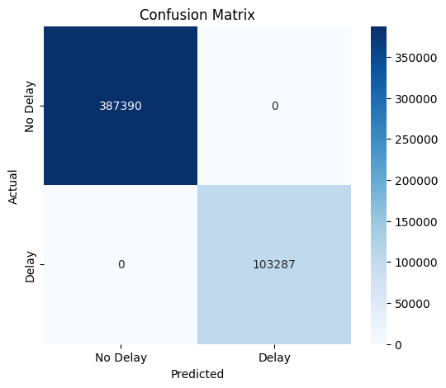
Logistic Regression Results
Accuracy: 100.00% Precision: 100.00%
Recall: 100.00% F1: 100.00%
All metrics were once again perfect
There were no false positives or false negatives
These results point towards a strong feature signal
Issues with this model:
Without determinant features as in our case, logistic regression suffers with non-linearly separable data

Slide 25
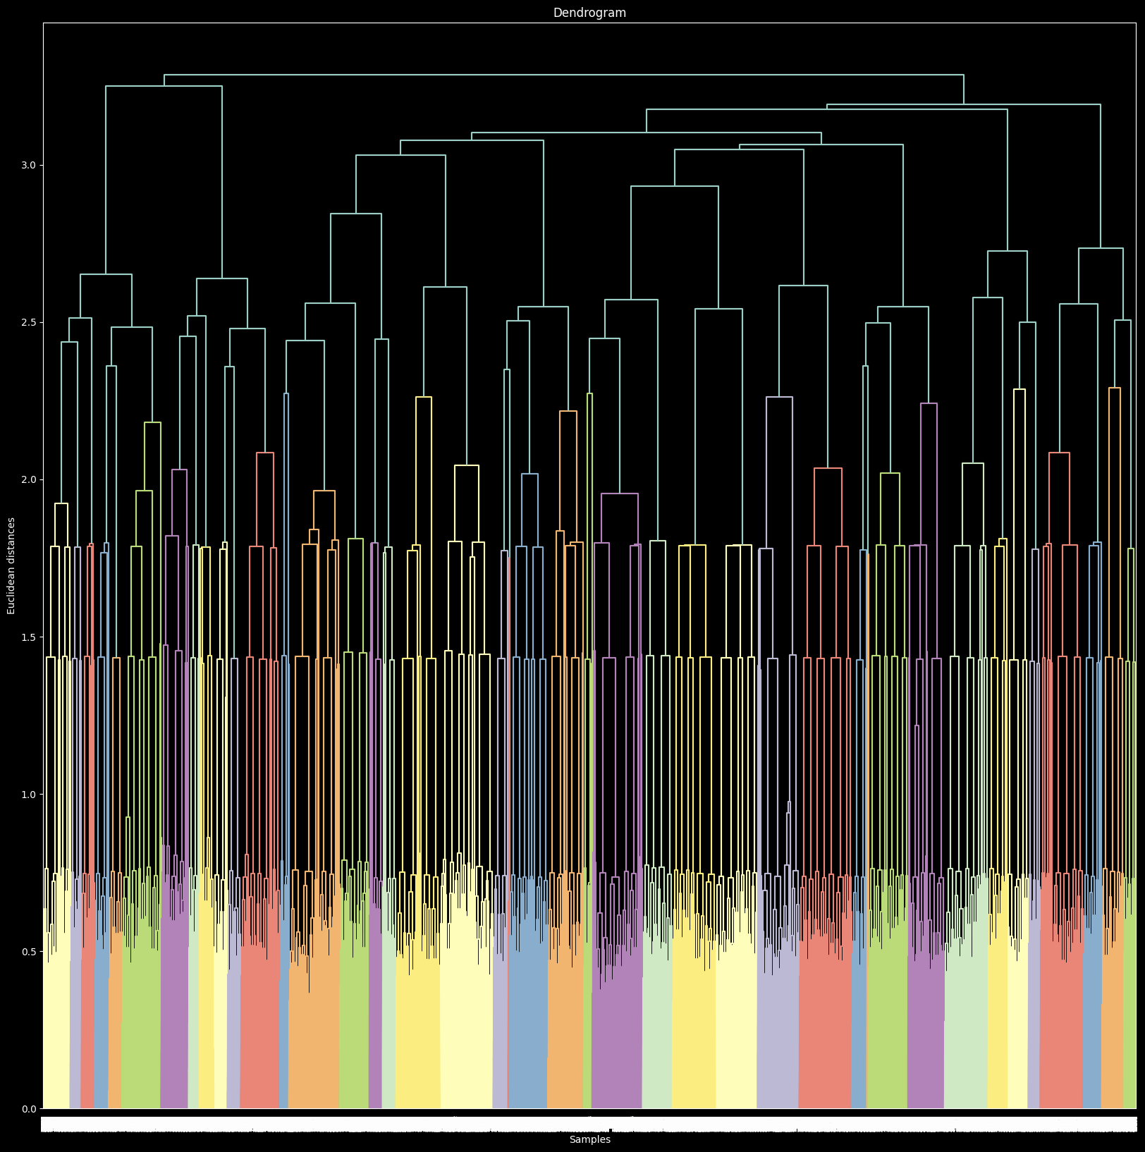
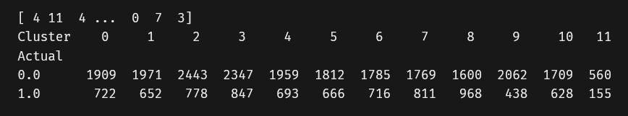
Hierarchical Clustering Results
How did I prepare the data?
For both the attributes and target I took the first 30k rows, due to issues with hierarchical clustering on large datasets.
Afterwards, I used the MinMaxScaler to transform and normalize the data
A big part of clustering is deciding what linkage method to use, and for this I calculated the Cophenetic Correlation Coefficient for each linkage method, to find which one best preserved the original distances. I found that the linkage method that best preserved the original distances was Average Linkage
After this, all I needed to do was find the optimal number of clusters for the algorithm
To do this, I used the Elbow method, which requires me to calculate the total intra-cluster variation (WSS), to find the specific point where adding more clusters does not give as much information
I found the optimal number of clusters to be 12
Here are the cross tabulation results

Slide 26
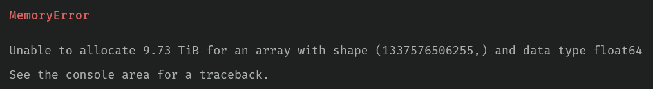
Hierarchical Clustering Issues
The biggest issue with Hierarchical Clustering is its requirements for time and memory. With an O(n³) time complexity and requiring Q(n²) memory, which makes it too slow for big datasets. In this instance, our dataset was far too large for the algorithm, requiring 9 TB of memory using all rows.
Therefore, I had to shrink the dataset and only use the first 30k rows. I tried going above 30k rows, but it started to take up tons of memory and time (just scaling it took 15 minutes, and the memory of my machine was maxed out - 32 GBs).
I did investigate other ways of setting up the hierarchical clustering (GPU acceleration and other softwares), but was not really satisfied with them (and in the case of the GPU acceleration, it just would not install).
I also needed to find out how I wanted to cluster, and researched the different methods, and when to use them

Slide 27
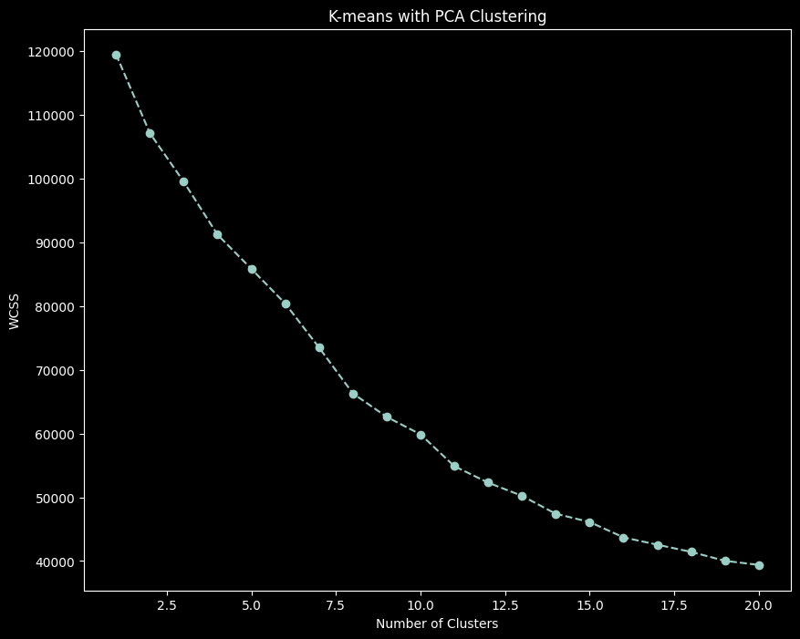
K-Means Clustering Results
How did I prepare the data?
For K-Means, I decided to use Principal Components Analysis (PCA) to further improve the performance of the algorithm, and to alleviate issues. This was done by analyzing and then reducing the number of components.
With PCA, I could calculate the optimal number of clusters via the Elbow method and by calculating the Within Cluster Sum of Squares (WCSS)
I found the optimal number of clusters with the dataset to be 11.

Slide 28
K-Means Clustering Issues
One of the major issues with the K-Means algorithm is minimizing inertia (measure of how internally coherent clusters are). Its biggest issue is that it is not normalized, which runs into problems with high-dimensional spaces. This dataset is high-dimensional, so to alleviate this issue, I used the dimensionality reduction algorithm PCA
The elbow method for finding the optimal number of clusters can be unreliable and subjective, since it depends on what the cutoff point is to the researcher
other issues I encountered were similar to Hierarchical clustering (computationally expensive for large datasets, and how I wanted to cluster)

Slide 29

Questions?

